Slide 1

Developing Android Apps with Kotlin

Slide 2

Introduction
Introduction
OS and platform for mobile devices
Started in 2005
Is based on Linux

Slide 3
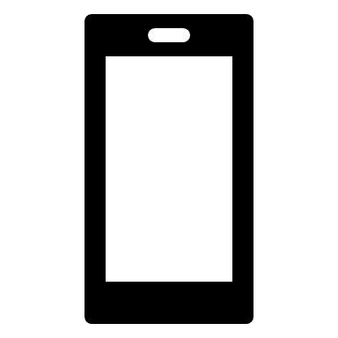
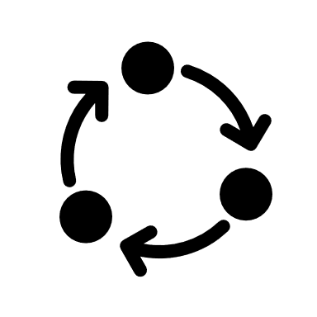


Introduction
Activities
Components
Services
Broadcast receivers
Content providers

Slide 4
Introduction
Why Kotlin?
Recommended by Google
Compatibility with Java
Null Safety
Brevity
Components
Why Kotlin?

Slide 5


Introduction
Popular Frameworks
Components
React Native
Why Kotlin?
Flutter
Popular Frameworks

